Slide 1

CS 533 INTRO TO DATA SCIENCE
Michael Ekstrand

Slide 2
GENERAL TIPS

Slide 3

Learning Outcomes
Some concluding tips for your data science work.
Photo by Sam Dan Truong on Unsplash

Slide 4

Questions
Good questions are fundamental
Tukey:
Far better an approximate answer to the right question, which is often vague, than an exact answer to the wrong question, which can always be made precise.
Photo by Jon Tyson on Unsplash

Slide 5

Work Reproducibly
For many, many reasons.
But accurate description is easier if work is reproducible (and internally reproduced).

Slide 6

Never Lose Context
Keep the big picture in mind
Goals — Questions — Analysis — Data
Keeping the goal in mind helps with:
Contextualizing results
Identifying limitations
Generating next ideas
Photo by Adrian Dascal on Unsplash

Slide 7

Don’t Overlook Detail
Be precise and specific in specifying questions and results
Always know what, precisely, you are measuring
Communicate precise results & definitions
Put them in context
Photo by dorota dylka on Unsplash

Slide 8
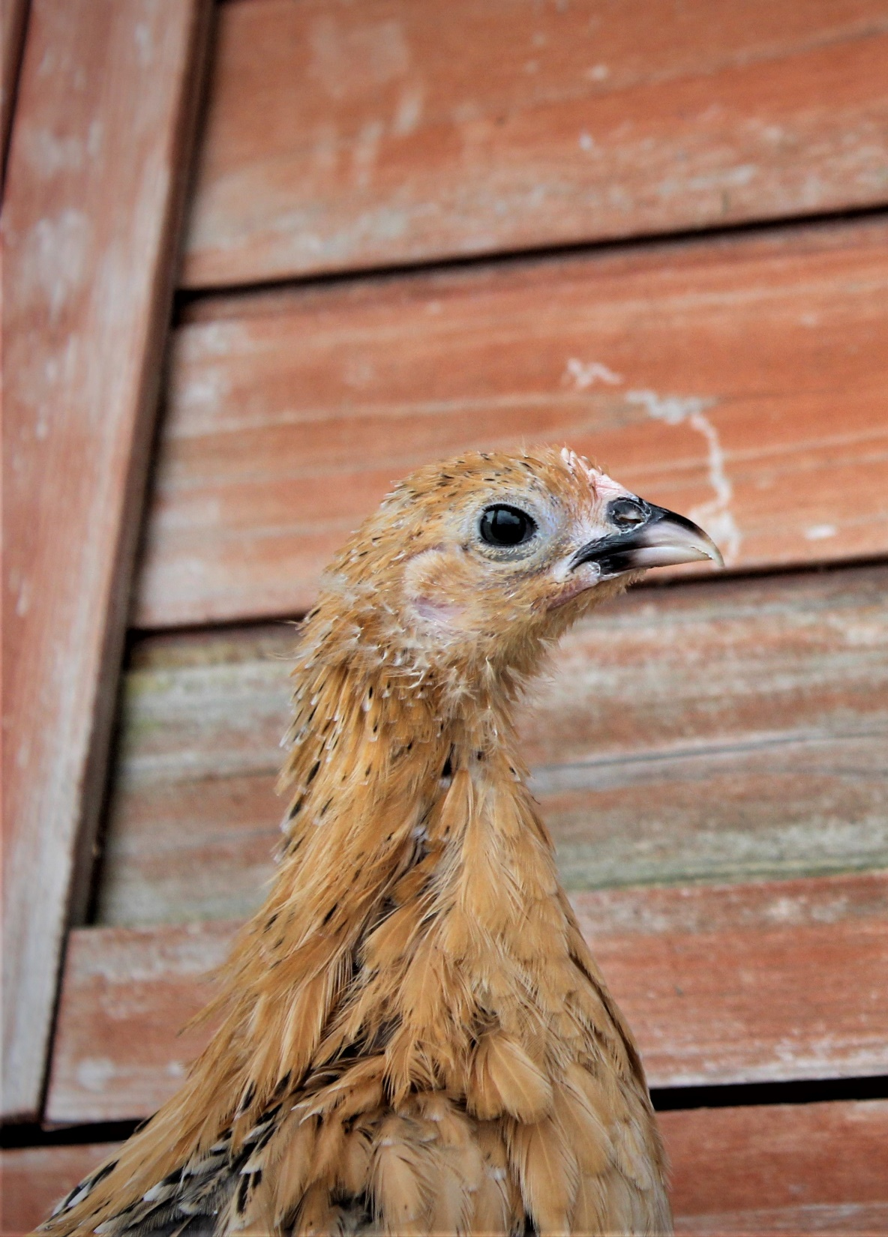
Be Curious
Learn more about statistics
Learn more about applications
Learn more about anything interesting
Photo by Siora Photography on Unsplash

Slide 9

Pause and Reflect
Photo by Lukasz Saczek on Unsplash

Slide 10

Wrapping Up
Good data science requires ongoing reflection, study, and practice.
Try to do better science tomorrow than you did yesterday.
Photo by Jan Tinneberg on Unsplash

